Slide 1
Black Twitter Project Update
01/26/2022

Slide 2
Negative Filter List (Non-Black Indicators) (Updated)
Manually selected from reviewing 2500 tweets retrieved through bio keyword search method.
keywords
non-black
black and white
black & white
black and blue
black & blue
black cat
black tea
black belt
black rock
black butler
black pink
acid black cherry
black country
black coffee
black clover
black swan
black panther
black rose
black box
black widow
black hole
black sheep
black metal
black shadow
black lagoon
black dress
black magic
black sabbath
black hair
black noir
black dog
black lines
black sea
men in black
black cab
black cabs
black mirror
sirius black
regulus black
black desert
black hawks
black creek
black christmas
black suit
black forest
daemon black
black survival
black sails
black jack
black label

Slide 3
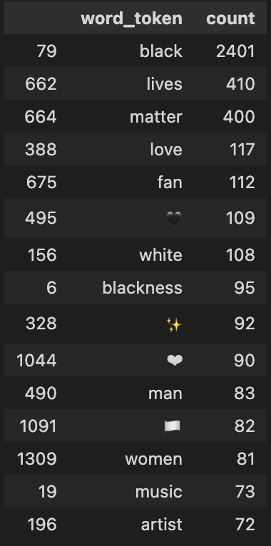
Top-Occurring Word Tokens in 2500 Labelled Tweets
Black-related tokens: black, lives, matter, blackness, 🖤

Slide 4
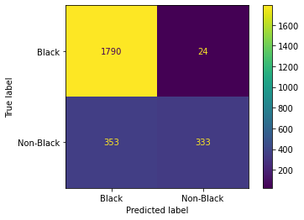
Rule-Based Classifier Using Negative Filter List
Accuracy: 0.8492

Slide 5
Black Twitter Project Update
12/15/2022

Slide 6
Negative Filter List (Non-Black Indicators) (Updated)
keywords
non-black
black and white
black & white
black and blue
black & blue
black cat
black tea
black belt
black rock
black butler
black pink
acid black cherry
black country
Side notes:
Should “blm” be added into the keyword search list?
Annotated entries are currently around 1200 (we have roughly 20000 entries in total as of now). Around how many annotated entries will be sufficient?
black coffee
black clover
black swan
black panther
black rose
black box
black widow
black hole
black sheep
black metal

Slide 7
Black Twitter Project Update
12/08/2022

Slide 8
Negative Filter List (Non-Black Indicators)
keywords
non-black
black and white
black & white
black and blue
black & blue
black cat
black tea
black belt
black rock
black butler
black pink
acid black cherry
black country

Slide 9
Black Twitter Project Update
12/01/2022

Slide 10
Frequent Word Tokens (Influencers Re-analysis)
Word Token Counts (Black Influencers)
Word Token Counts (Non-Black Influencers)
 | word_token | count
0 | rt | 415154
153 | people | 68238
1824 | 😂 | 52109
1239 | black | 51419
62 | one | 49872
1839 | 😭 | 44548
1092 | thank | 40675
138 | time | 33711
170 | love | 31772
122 | think | 27316
39 | new | 25465
149 | today | 24755
1883 | lol | 24154
941 | day | 22595
1754 | 💖 | 22019
 | word_token | count
0 | rt | 103087
174 | people | 23805
597 | one | 17321
520 | new | 16064
1390 | c | 16049
1332 | thanks | 15953
49 | covid | 15462
4270 | central | 15129
5151 | comedy | 14670
5148 | #norafromqueens | 14622
5150 | 10/9 | 14569
402 | 2 | 14352
155 | #covid19 | 14210
545 | today | 14061
478 | trump | 13502

Slide 11
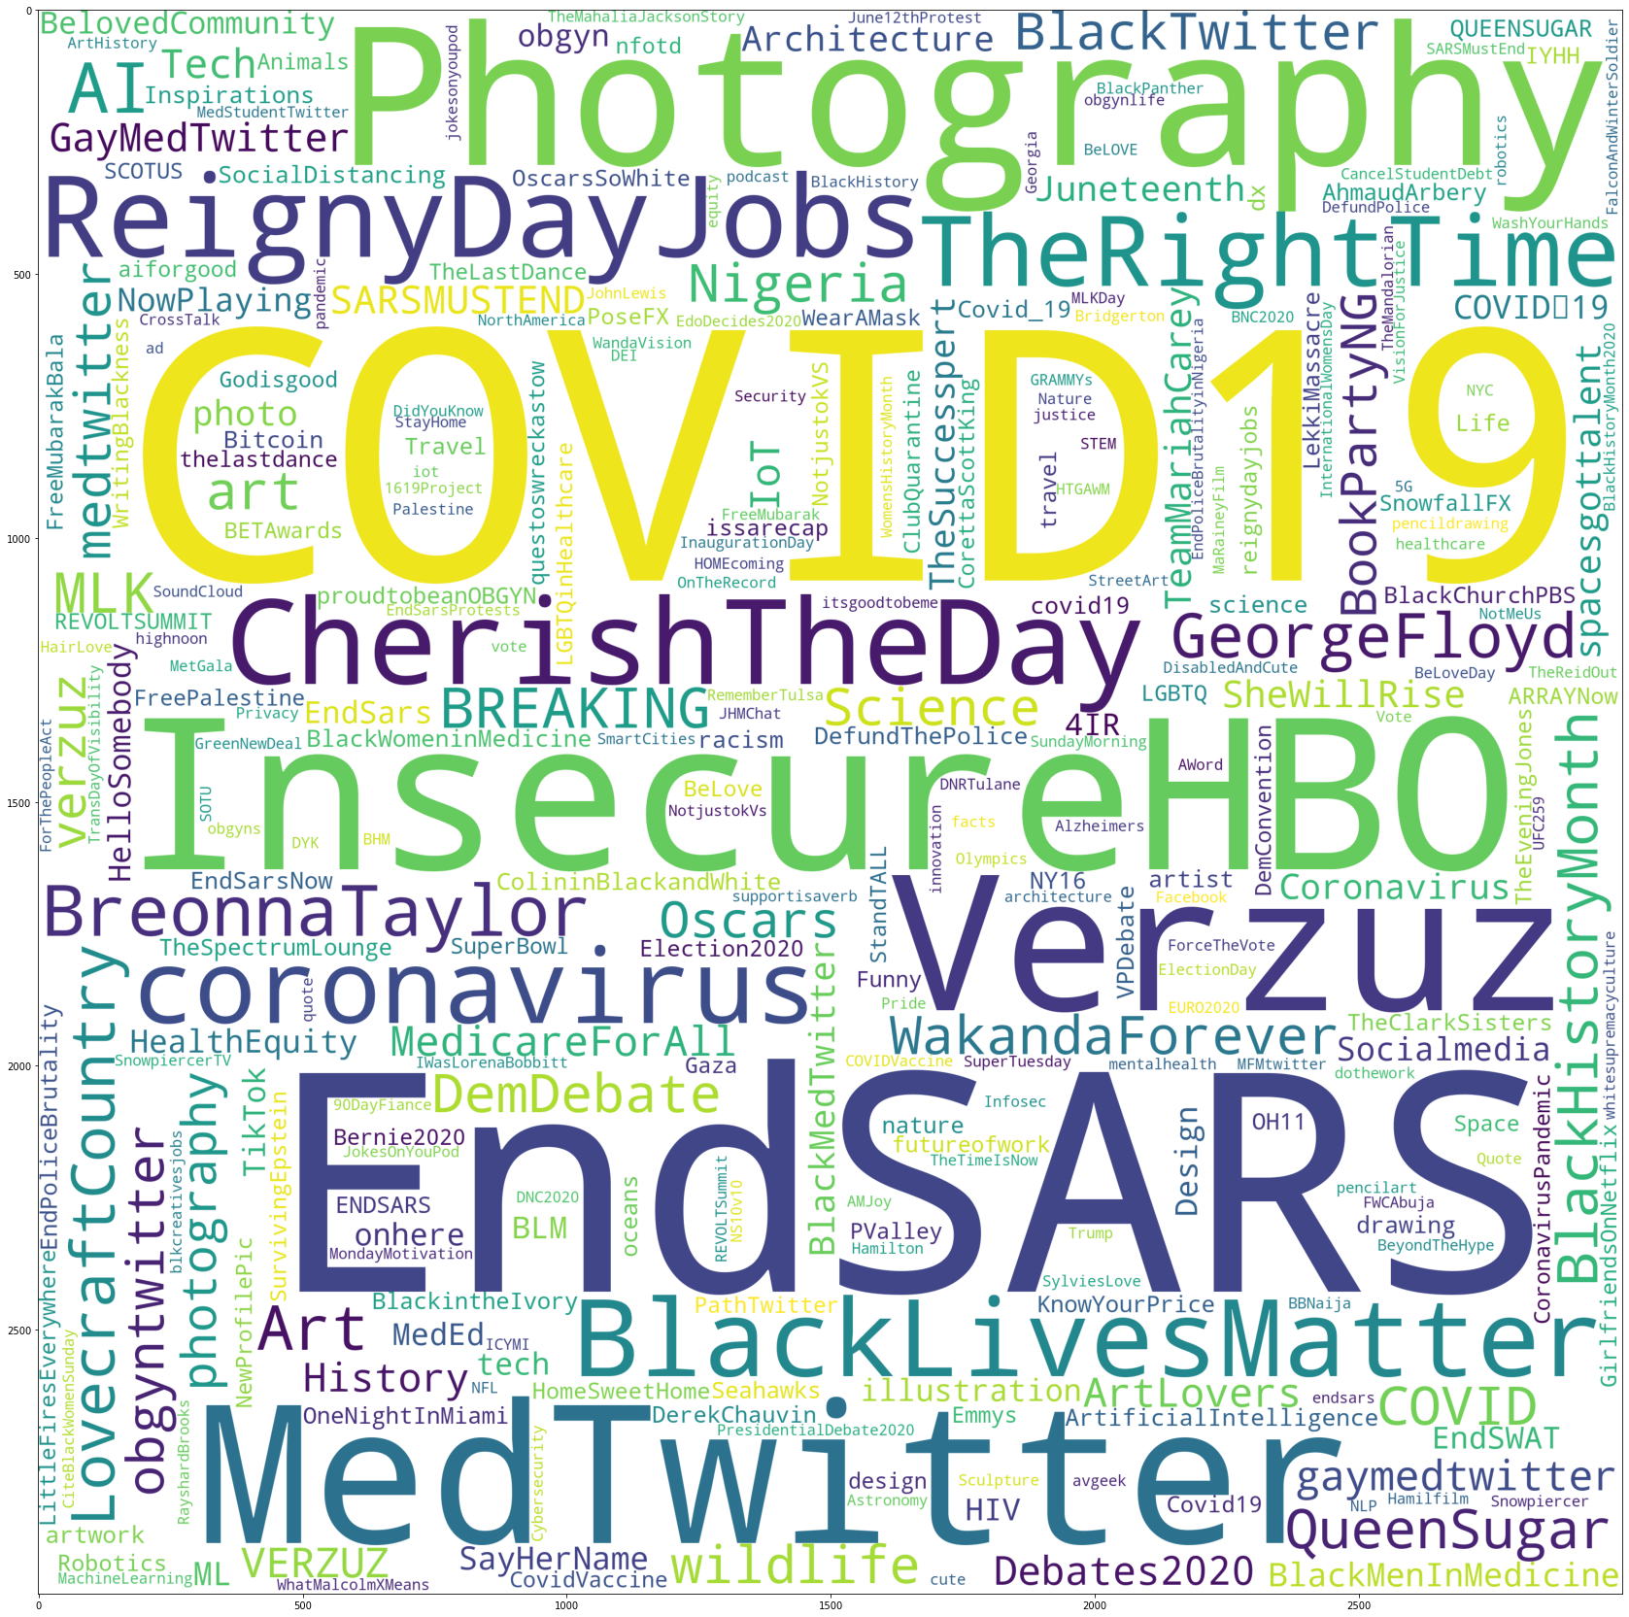
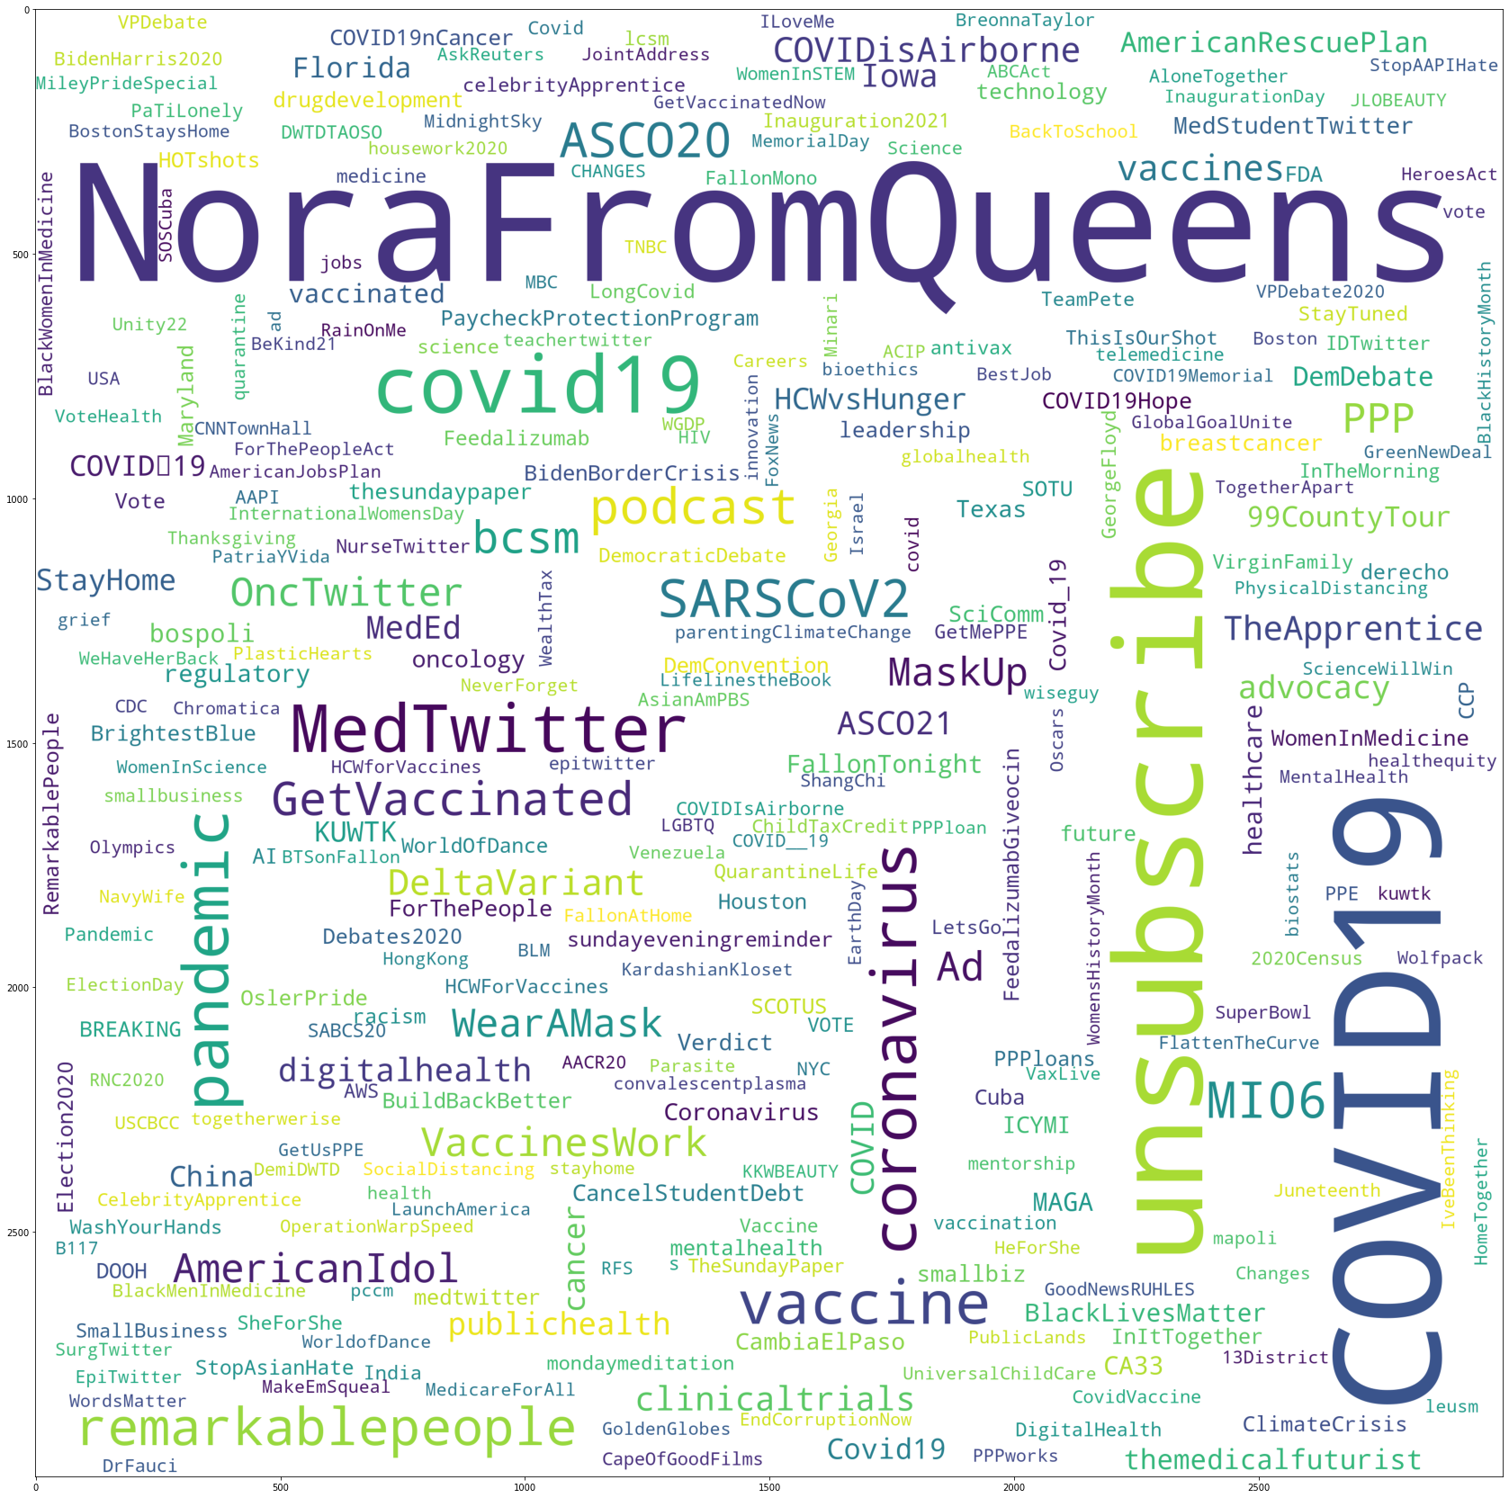
Hashtag WordClouds (Influencers Re-analysis)
Black Influencers
Non-Black Influencers

Slide 12
Frequent Word Tokens (Partial 200 New Users)
 | word_token | count
11 | rt | 467381
46 | 😂 | 65613
159 | people | 51951
127 | black | 50407
688 | 😭 | 35094
52 | one | 34933
208 | 🤣 | 34698
172 | time | 24385
510 | love | 24243
122 | white | 21648
90 | day | 19624
432 | new | 19310
684 | de | 18947
113 | think | 18744
947 | today | 16463
1099 | man | 16098
1479 | right | 15483
1057 | back | 15325
530 | said | 15047
568 | ❤ | 14981
195 | first | 14388
1362 | women | 14110
4074 | 1 | 13842
81 | way | 13761
212 | thank | 13756
2206 | work | 12931
1848 | please | 12258
80 | trump | 12247
43 | lol | 11884
146 | 2 | 11852
1306 | life | 11832
456 | shit | 11451
327 | always | 11398

Slide 13
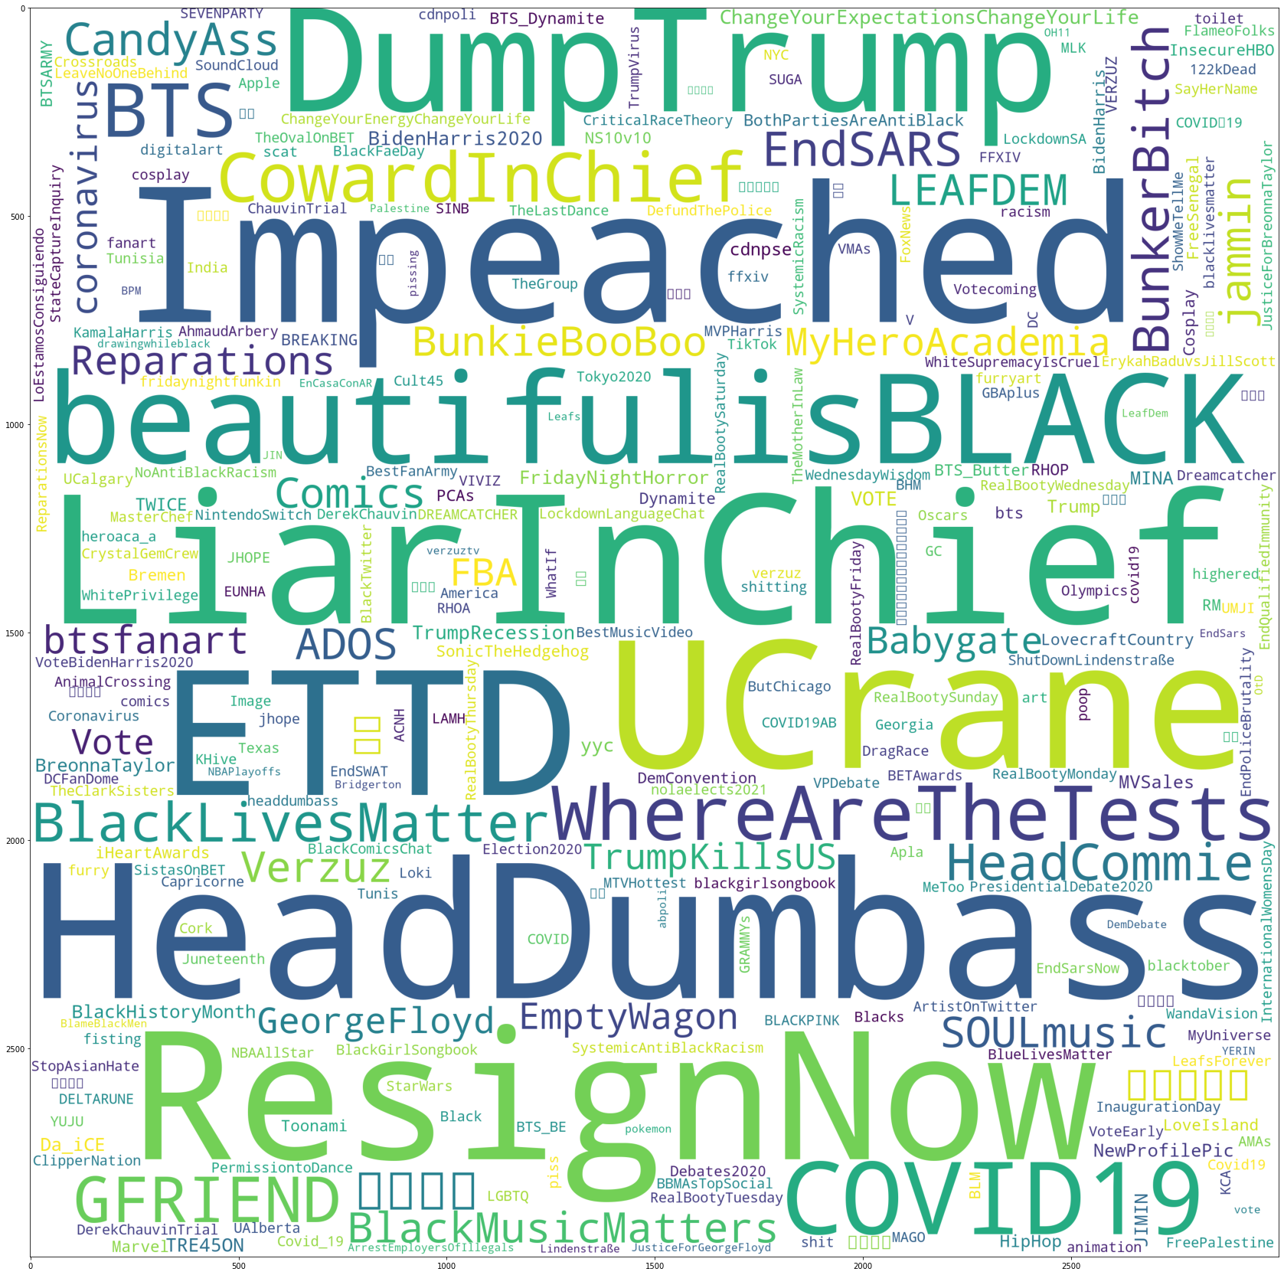
Hashtag WordClouds (Partial 200 New Users)

Slide 14
Black Twitter Project Update
11/17/2022

Slide 15
 | twitter_user_id | User_Name | Description
100 | 867932737 | cozywithwhoiam_ | phd person @qmul she/ her | flora, blackness, feminism, poetry. ease. hive. panda.
101 | 1514622111054192647 | ShawnReneeB | 🗣Against anti-Black Hate 🗣Advocate for Social Justice 🗣Pro #Reparations for American Freedman
102 | 17586129 | abolitionista | Professing on Blackness and Gender. Berkeley born and raised!
103 | 1347735873215979521 | wolfleesiyeon | And the blackness returned- also known as home sweet home.◼️ ~just another misfit.
104 | 3045656889 | HeroesInColor00 | Blog dedicated to Racial&cultural diversity in comic books and related works Migrant, mixed, non-Black Latino (Venezuelan) 🇻🇪 https://t.co/mwGwCjTDOk
105 | 97697553 | JBPrattJrPhD | Associate Professor of Criminal Justice @fisk1866 | Thinking about violence, blackness, music, justice, & culture | ΦMA ΑΦΑ | Views my own & represent me alone.
106 | 75580549 | asize12 | God is EVERYTHING🙏🏾Music lover🎶 I love drawing✍🏽Proud Autism Mom🧩Kidney transplant survivor💪🏾 I love my blackness & yours✊🏾RIH Daddy, Meka & Netta🕊🕊🕊
107 | 1540175625159417856 | BlackFather_B1 | Sharing my views and retweeting others…📚 #ThankGod🙏🏾 #BlackAmerican #BlackFathersMatter #NuclearFamily #ReparationsNow -No tolerance for Anti-Black Misandry
108 | 544795471 | SpenStillTalkin | I'm here to crack jokes, have fun, and exude unapologetic Blackness. Zero tolerance for Black Woman slander 🙅🏿‍♂️#Saints LA born but Mississippi raised
109 | 263394041 | SUPERi0R_422 | Writer|Creative|Designer Duality is at the core of all Black success. So… holding my Twitter against me is … Anti-Black.
110 | 1425140716678885386 | ATAartistry | Black American (FBA)(DOS) Musician No Anti-Black Racism
111 | 16211073 | hofrench | Author: Born in Blackness: Africa, Africans and the Making of the Modern World: 1471 to the Second World War. (Liveright: Oct. 2021) Columnist @ForeignPolicy
112 | 223346941 | brownisthecolor | prof @ UCSC. Black study, translational + transnational blackness, disaster, diaspora, Palestine. Fond of toast. Often bruised. she/they.
113 | 1425436550 | ScipioCk | he/him/his. Dad. Public Servant /dismantling anti-Black racism+all interlocking forms of oppression/ #antiracist #goodtrouble #BENREN #IPPIHub tweets=mine only

Slide 16
Black Twitter Project Update
11/10/2022

Slide 17
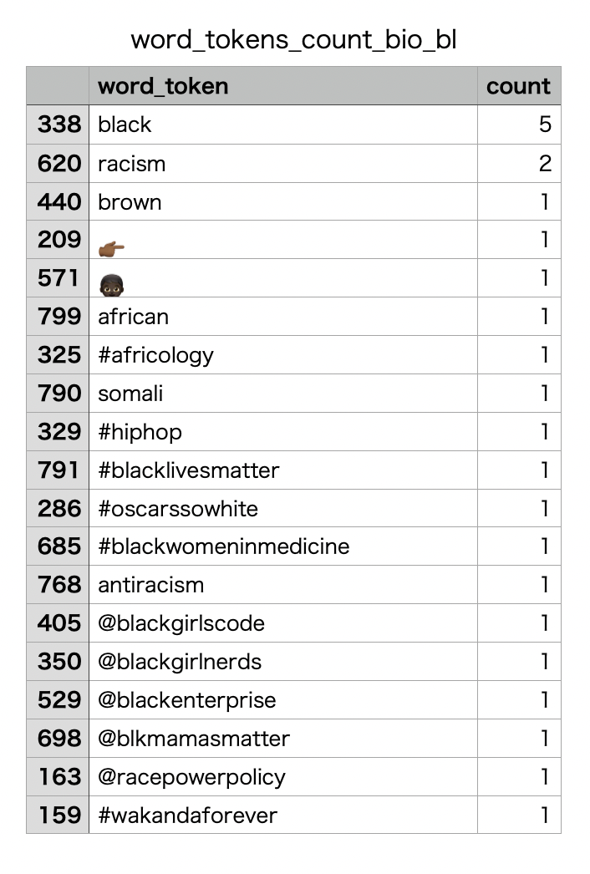
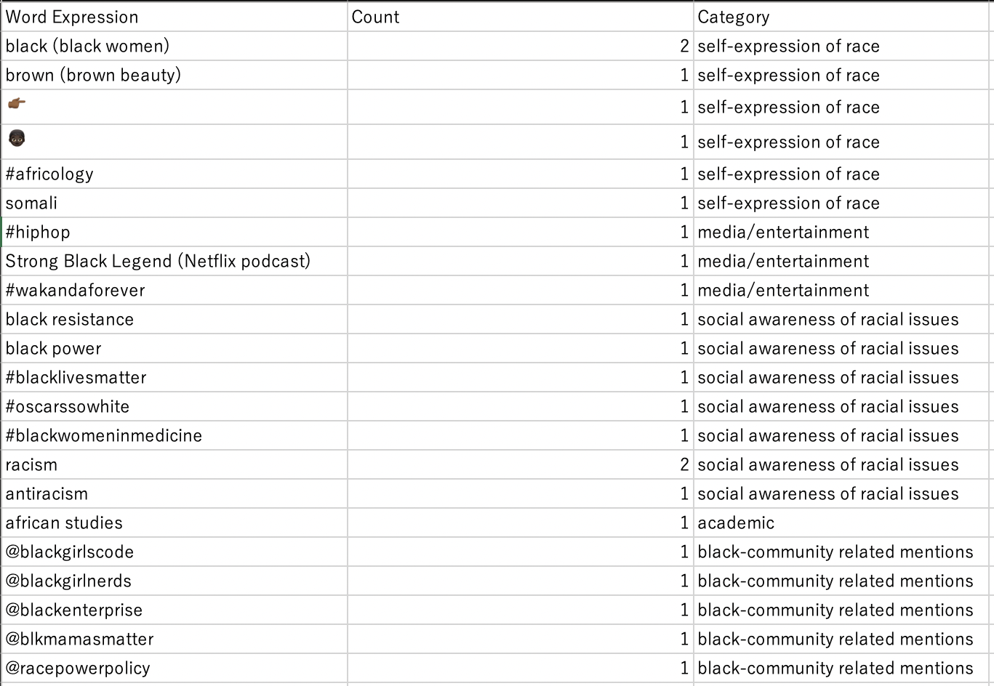
potentially black-related keywords used by 97 black influencers in bios
potentially black-related word expressions categorized

Slide 18
Black Twitter Project Update
11/03/2022

Slide 19
Full Archive Search Pipeline Update
full_archive_search_bl.py: using list of user handles to retrieve historical tweets of the user within our specified timeframe
→ As this is Full Archive Search, we are getting a higher number of tweets for certain users than we did with Jessica’s method as now we are free of the most recent 3200 tweets limit
Updates in the black influencer list: two users have changed their handle names:
emarvelous → errinhaines
JAjueny → jaxajueny
Issues to be solved: Full Archive Search has the rate limit of 1 call per second & 300 calls per 15 minutes
→ Keep encountering error code 429: exceeding rate limit
→ Currently I set the program to sleep for 2 seconds after every time we make a connection to the endpoint & 15 minutes every time we encounter a 429 error but this makes the data scraping process very long
*** Will ask Ashley about timeout problem

Slide 20
AAE
African-American English (AAE) has had several different names:
African-American Language (AAL)
African-American Vernacular English (AAVE)
Black English
“Ebonics”: not used anymore since co=opted by white speakers as a derogatory term
AAE is a complete and distinct sociolect: a dialect created by social rather than regional boundaries
The arrival of White Lion in the US in 1619 marked the beginning of AAE. There are several theories regarding the foundation of AAE:
Pidgin: a grammatically simplified form of a language used between people without a common language
A result of English words being dropped into African grammar
Most popular theory: it grew out from the dialect Old Southern American English spoken by white rural southerners at that time

Slide 21
AAE
Features and patterns that “index” AAE:
Common phonological features in AAE
TH stopping: [D] replaces [TH], e.g. dis, dat
Consonant cluster reduction: multiple consonants at the end of a word are simplified into one
Metathesis: the transposition of two letters or speech sounds
Common grammatical patterns in AAE
Double negative: second negative serves to confirm or amplify the negation (negative concord
Possessive s absence
Question word order, e.g. Why they ain’t going?
“Finna” (“fixing to”) might replace “going to” or “gonna”
Zero copula: connecting verb “to be” removed from sentences where they can form a contraction, e.g. “Who that?:, “She my sister.”
No ‘-s” on third person singular
Source: https://www.youtube.com/watch?v=1YxH43Cw6tI

Slide 22
Black Twitter Project Update
10/27/2022

Slide 23
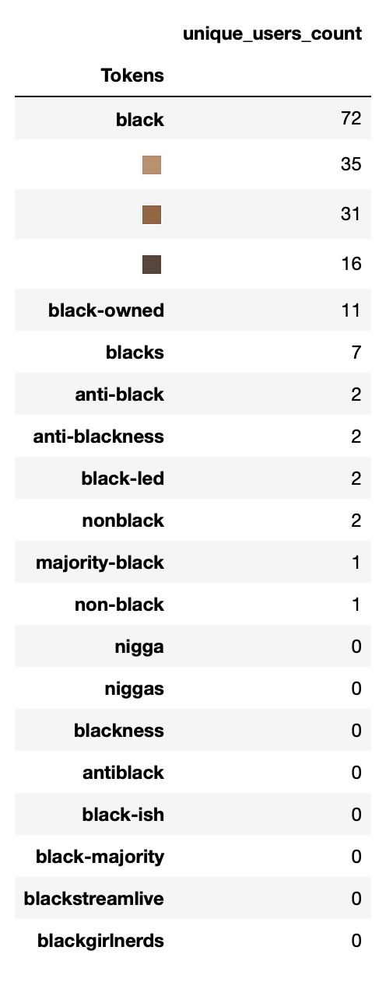
Black-related tokens and the two racial-insensitive words (non-black influencers)
How many unique users use the word tokens in our word list? → Unique user count for each word token (sorted in descending order)
The word token “black” and the skin color emojis are still used by a number of non-black influencers, though not as many as black-influencers
For non-black influencers, none of them use the two racial-insensitive word tokens

Slide 24
Do any of the black influencers NOT use the black-related word tokens in our list?
Out of a total number of 94 users
(-1 excluding jeremyfaust, the last 2 may have been lost through the data scraping process? → will have to check)
(one of the users in Jessica’s list seem to be an empty profile → account may have been something)
→ 92 of them use black-related word tokens, 2 do not
The two users that do not use black-related tokens (just for reference):
→ user_id 457313, 31239408

Slide 25
Black Twitter Project Update
10/20/2022

Slide 26
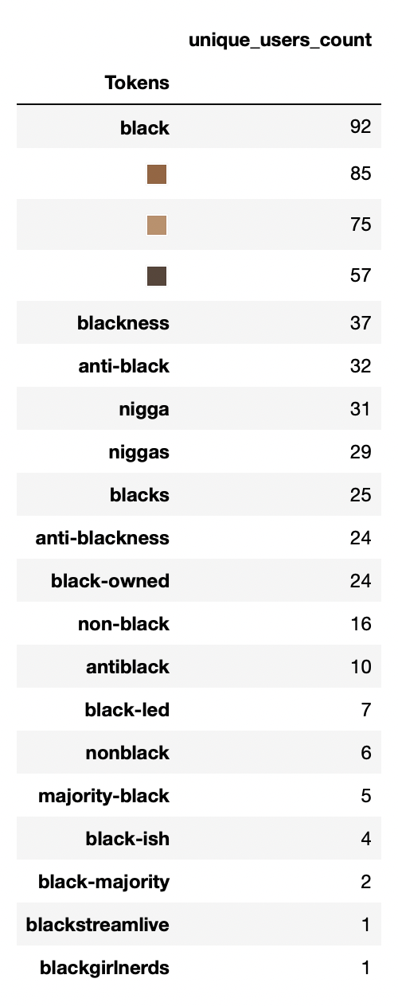
Black-related tokens and the two racial-insensitive words
(black influencers)
How many unique users use the word tokens in our word list?
→ Unique user count for each word token (sorted in descending order):
(ran on original black influencer tweet data excluding jeremyfaust due to unsolved data scraping pipeline issues)
For the two racial-insensitive words: of the users that use these words, how many users use the other word tokens in the list?
→ 36 users in total use the two racial-insensitive tokens (31 use n***a and 29 use n****s)
→ from our sample, all 36 users that use the racial-insensitive tokens also use other word tokens in the list

Slide 27
Regarding Filtered Stream
Does the stream capture the whole Twitter population, or just a sample portion of it?
→ It filters all tweets and returns the ones matching your specified rules until the retrieved tweets reach a 1% limit of the whole population in real-time.
→ In other words, if the tweets that match your rules account for less than 1% of the firehouse, you will retrieve all the tweets that match your rules at that moment.
How many calls does the stream make while it is up running? (efficiency issue)
→ Each tweet pulled from the Filtered Stream counts as part of the 500,000 monthly tweet cap usage (higher cap for Academic Access)
*** One thing to note, Filtered Stream retrieves every tweet that matches your rules. Seeing as we’re specifying rules for keyword search in bios, if a user that matches our rules tweet multiple times during the timeframe when we’re running our stream, we will retrieve multiple tweets of that user (which may be not so efficient)
Filtered Stream rule cap: 5 for Essential Access, 25 for Elevated Access, 1000 for Academic Access
Possible to-do: Update Access level to Elevated or Academic Research (see what is needed for updating access level)

Slide 28
Regarding Filtered Stream (cont.)
Question: Currently we’re using top-occurring black-related tokens from tweets to run the Filtered Stream on user biographies
→ Should we use top-occurring black-related tokens from bios instead? But these are scarce in number.
***Problem regarding original data scraping pipeline:
Jessica used GET /2/users/:id/tweets, which allows us to specify the timeframe we want to search in, but only the most recent 3200 tweets are available. Thus, if the timeframe we specify is out of the most recent 3200 tweets, we will not be able to retrieve any results.
→ Substitutional option: use Full Archive Search (will need Academic Research Access)
https://github.com/twitterdev/Twitter-API-v2-sample-code/blob/main/Full-Archive-Search/full-archive-search.py

Slide 29
AAE/AAVE-related publications from the scholars from the AAE/AAVE video
1. Dr. Hiram Smith, Ph.D. in Spanish, Bucknell University
“Has nigga been reappropriated as a term of endearment? (A qualitative and quantitative analysis)” https://read.dukeupress.edu/american-speech/article-abstract/94/4/420/139031/Has-nigga-Been-Reappropriated-as-a-Term-of
2. Dr. Sonja Lanehart, Ph.D. in English Language and Linguistics, University of Arizona
“African American Vernacular English in Education: The Dynamics of Pedagogy, Ideology, and Identity.” https://www.sonjallanehart.com/uploads/3/7/0/5/37059841/lanehart_1998.pdf
(roughly related to our topic) “The Language of Identity.” https://www.sonjallanehart.com/uploads/3/7/0/5/37059841/lang_of_identity.pdf

Slide 30
AAE/AAVE-related publications from the scholars from the AAE/AAVE video (cont.)
3. Minnie Annan, Ph.D. candidate in Linguistics, Georgetown University
“African American language and education: How far have we come?” https://scholar.google.com/citations?view_op=view_citation&hl=en&user=LS0FxkoAAAAJ&citation_for_view=LS0FxkoAAAAJ:u5HHmVD_uO8C (cannot find available PDF version online; publication was published by University of Michigan Press)
4. Christopher Hall, Researcher and Senior Facilitator at CulturePoint
“Grammatical Reanalysis and the Multiple N-Words in African American English” https://static1.squarespace.com/static/53812953e4b02ca8a934eebf/t/5c9e409fef067500012eb95d/1553875104615/Nwords2019_FinalSubmission+11-56-28-298.pdf (discusses the functions of n-words in AAVE)
“Semantic Bleaching and the Emergence of New Pronouns in AAVE” https://www.researchgate.net/publication/281316950_Semantic_Bleaching_and_the_Emergence_of_New_Pronouns_in_AAVE (talks about how some registers of AAVE have started to use n-words as pronouns to refer to oneselves and how this may lead to semantic bleaching of the n-words based on their new functions)
“Corpus-Based Sociophonetic Approaches to Postvocalic R-Lessness in African American Language” https://www.researchgate.net/publication/329406677_Corpus-Based_Sociophonetic_Approaches_to_Postvocalic_R-Lessness_in_African_American_Language (discusses the r-lessness after vowels in AAL from sociophonetic aspects)

Slide 31
Black Twitter Project Update
10/13/2022

Slide 32
Doing keyword search on user bios in Twitter API
GET users/search (Twitter API Standard Version 1.1):
Searching mechanism is unclear. Targeted keyword appears in user name, in bio description, or neither of the two (possibly appearing in other fields). Cannot specify fields for which to do keyword search.
-> Unstable
Filtered Stream (Twitter API Version 2):
Runs a continuous stream that captures live tweets that are tweeted when the stream is running -> Keeping the stream running can ensure a larger number of results
Can specify field for which to do keyword search: searching in user bios is feasible!
Can specify multiple streaming rules at the same time: do not need to run multiple streams for different keywords
Drawback: Due to the nature of live streams, cannot capture users that are not tweeting during the time the stream is active (also cannot capture historical users who no longer tweet) -> Nonetheless, we can still search for active users who have black-related tokens in their bios, and scrape their tweets during the COVID-19 timeframe
Code pipeline: filtered_stream.py: keeps the stream running and writes results into a json file (filtered_stream_users.json) filtered_stream_tocsv.py: takes the json file from filtered_stream.py and transforms the data into csv format (filtered_stream_users.csv)

Slide 33
twitter_user_id | User_Name | Description | Time_Account_Created | Number_of_Followers | Number_Following_Users | Number_of_Tweets | Listed_Count | Location
825845766 | ProfessorTKH | Prof of Law @FordhamLawNYC New Book "Racial Innocence: Unmasking Latino Anti-Black Bias" @Bookshop_Org Order now @ https://t.co/sO4VWwcbla | 2012-09-15T19:42:32.000Z | 2486 | 639 | 762 | 27 | None
1492041882704220161 | PrintsPuleng | Beautiful, affordable, digital printable art celebrating blackness in all its beauty. | 2022-02-11T07:45:15.000Z | 26 | 110 | 144 | 0 | None
246013324 | Nana_ILLy | Mother of 2 royal babies. Baker/Hairstylist/Crafter. Deeply into culture, ♥conscious music, read'n, sing'n n writ'n. Embrac'n my BLACKNESs lov'n me n liv'n life | 2011-02-01T23:14:24.000Z | 190 | 153 | 8745 | 1 | Lioness Thrown
Sample data from filtered_stream_users.csv
* Keywords used for testing: “blackness”, “anti-black”, “anti-blackness”, “non-black”

Slide 34
AAE/AAVE/AAL
African American Language (AAL):
Language spoken by or among African Americans (the origination of the language variety)
Not every black person speaks AAL
Not everyone who speaks AAL is black
African American English (AAE):
A grammatical system does exist
As it is systematic and rule-governed, one could violate its grammatical rules and do it wrong
Has multiple registers, which can be a continuum from the basilecto (most divergent) form to the acrolecto (most educated) standard
* AAL & AAE seem synonymous
African American Vernacular English (AAVE):
Is one register of AAE
Not all AAE is AAVE
Source: https://www.youtube.com/watch?v=a4NrrUtRShw

Slide 35
Black Twitter Project Update
09/13/2022

Slide 36
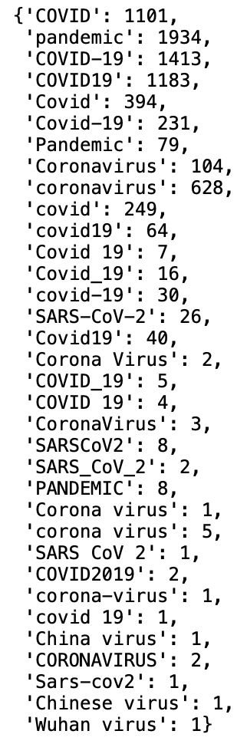
Among the black-related tweets, how many tweets do mention COVID?
⇒ 6633 out of 224103 tweets (using Xuan Lu, Qiaozhu Mei COVID-19 Filter)
Keywords: "covid 19", "covid 2019", "covid", "19 ncov", "2019 ncov", "ncov", "corona virus", "pandemic", "wuhan virus", "chinese virus", "china virus", "sars cov 2", "hcov 19", "ncov 19"
Keyword counts: (figure on right)
Possible To-Dos:
1. Identify new covid-related keywords from the filtered COVID-related tweets to add to the list
2. Topic modeling and sentiment analysis on COVID-related tweets?
***Note: While using the Twitter API Pipeline to retrieve black-related tweets, I found that Users LaBeautyologist (id: 31012378) and dondekojo (id: 175055258) are no longer public profiles

Slide 37
Unique profiles frequently using certain hashtags
Recording profiles and their frequently used hashtags in DefaultDict if value exceeds threshold
Randomly set threshold (for now): if hashtag count >= 10 and fraction (count of hashtag by single profile / count of hashtag by all profiles) >= 0.5 ⇒ Question: How should the threshold be decided?
Some interesting profiles (by ids) and black-related & covid-related hashtags: 17136795: ‘BlackBusinessMonth’ (10/11), 'blackmenexcel' (34/34), 'blackwomanpower' (14/14)
8071902: 'BlackTwitter' (45/54)
54617733: 'BlackHistoryMaker' (28/29), 'MLK' (307/324), ''MLKDay' (38/53)
130352142: 'BlackLifeAAIHS' (10/10)
846518452584173569: 'BlackMenInMedicine' (146/149)
197470016: 'BlackWhysMatter' (15/16), 'BlackWomeninMedicine' (15/22), 'COVIDVaccine' (13/21), 'COVIDVaccines' (10/17)
34169085: 'CiteBlackWomenSunday' (17/20), 'vaccinedreams' (14/14)
470708968: 'WinWithBlackWomen' (15/16)
12046642: 'MaskUpMichigan' (20/20)
35328942: 'vaccinate' (12/13)

Slide 38
Black Twitter Project Update
4/25/2022

Slide 39
Black Twitter Project Check-In 4/28/2022
Next Steps:
Identify traits of AAVE (African American Vernacular English) in tweets
Question for the stakeholder advisory group
co(de)-switching - context matters
Brainstorming on unintended consequences

Slide 40
Dimensions of Race
Racial identity ⇒ user biography (self-reported race from the user’s profile) & some of the users’ tweets (e.g. choose race-specific hashtags)
Reflected/Socialized race ⇒ users’ tweets and replies (the interactions with others in the way they addressed each other)
Other potential method
user’s neighbors: inference based on attributes of the user’s neighbors (people that users follow) - Zamal et al. (2012)
assumption: individuals tend to seek others who share similar attributes

Slide 41
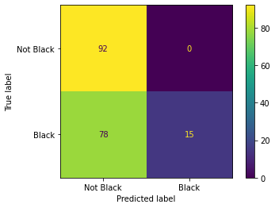
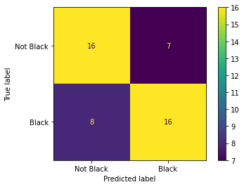
User Biographies
93 black influencers, 92 non-black influencers
(some not included due to lack of biographies)
rule-based model
If user biography included any black community related keywords
simple logistic regression model
75%-25% train-test split
words in biography text as features
accuracy = 0.58
accuracy = 0.68
Notes:
find where the “errors” are

Slide 42
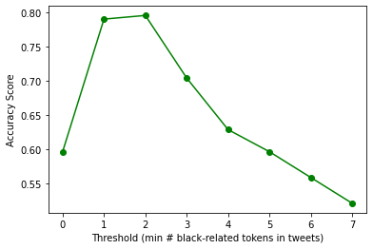
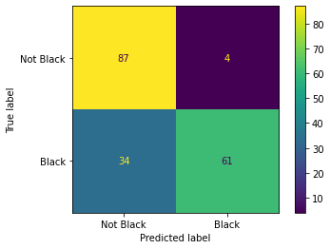
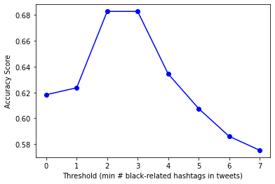
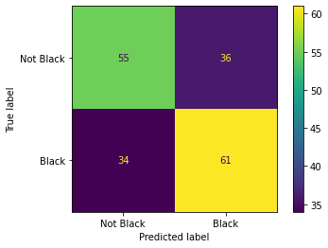
Tweets of Influencers
all tweets from influencers
rule-based model
threshold=2, accuracy = 0.797
keywords
threshold=2, accuracy = 0.68
4 users did not use hashtags (1 black influencer, 3 non-black influencers
hashtags

Slide 43
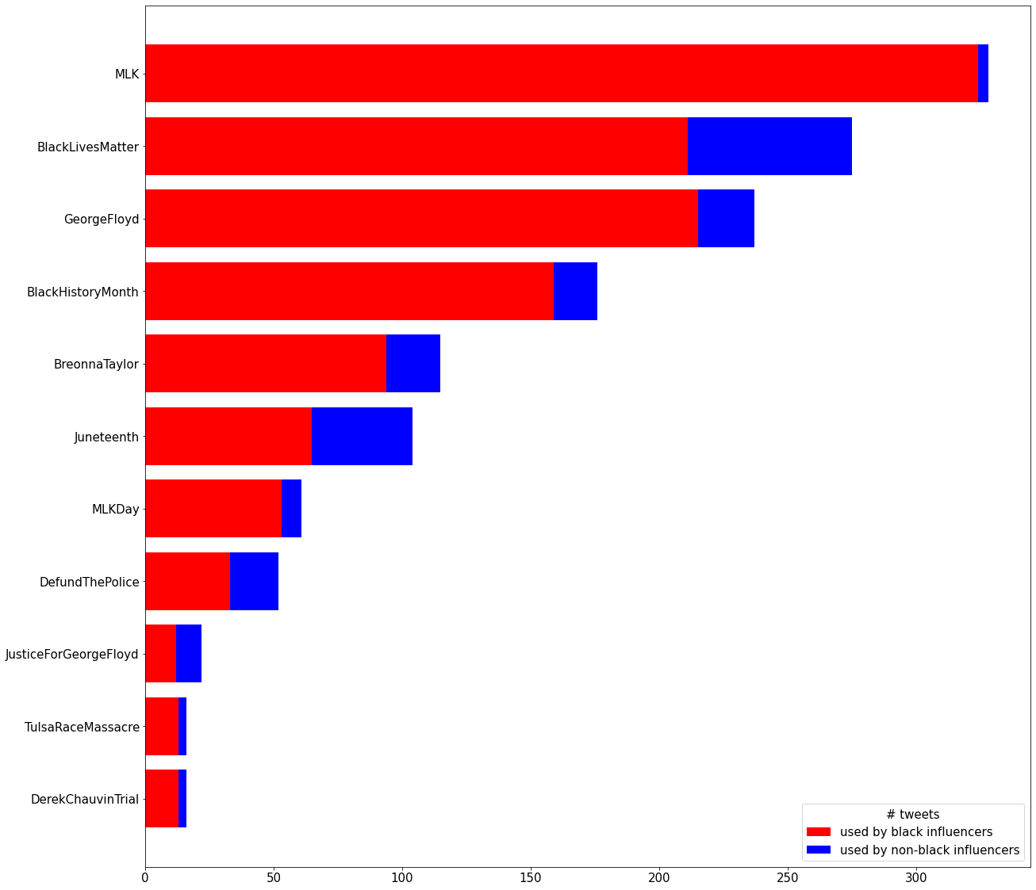
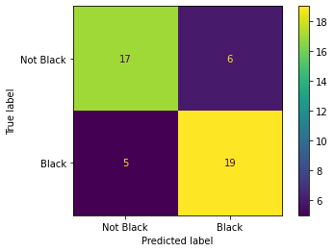
“Overlapping” Hashtags
Hashtags used by both non-black & black influencers
Tweets of Influencers
all tweets from influencers
simple logistic regression model
75%-25% train-test split
words in tweet text as features
10 black users, 3 non-black users
41 black users, 27 non-black users
31 black users, 9 non-black users
30 black users, 10 non-black users
26 black users, 13 non-black users
28 black users, 18 non-black users
9 black users, 8 non-black users
11 black users, 5 non-black users
accuracy = 0.77
6 black users, 5 non-black users
4 black users, 1 non-black user
4 black users, 2 non-black users

Slide 44
List of 97 Non-Black Influencers
DrKimSue | Kim Sue, MD, PhD
MartyMakary | Marty Makary MD, MPH
briantylercohen | Brian Tyler Cohen
Carl_C_Icahn | Carl Icahn
MikeBloomberg | Mike Bloomberg
richardbranson | Richard Branson
GuyKawasaki | Guy Kawasaki
Lord_Sugar | Alan Sugar
SarahPalinUSA | Sarah Palin
MittRomney | Mitt Romney
ashishkjha | Ashish Kumar Jha
PreetBharara | Preet Bharara
DrLeanaWen | Leana Wen, M.D.
darakass | Dara Kass, MD
FLOTUS | Jill Biden
drsanjaygupta | Dr. Sanjay Gupta
cha_myoung | Myoung Cha
AOC | Alexandria Ocasio-Cortez
wutrain | Michelle Wu
MrBeast | MrBeast
ConanOBrien | Conan O'Brien
markiplier | markiplier
Twitter_Handles | Name
taylorswift13 | Taylor Swift
selenagomez | Selena Gomez
JoeBiden | Joe Biden
BillGates | Bill Gates
LucyLiu | Lucy Liu
NoraFromQueens | Awkwafina
SimuLiu | Simu Liu
justinbieber | Justin Bieber
jimmyfallon | Jimmy Fallon
KylieJenner | Kylie Jenner
akshaykumar | Akshay Kumar
beingsalmankhan | Salman Khan
Harry_Styles | Harry Styles
ladygaga | Lady Gaga
KimKardashian | Kim Kardashian
jtimberlake | Justin Timberlake
ddlovato | Demi Lovato
MileyCyrus | Miley Cyrus
JLo | Jennifer Lopez
DisguisedToast | Toast
katyperry | Katy Perry
Valkyrae | Valkyrae
JeffBezos | Jeff Bezos
IvankaTrump | Ivanka Trump
TomiLahren | Tomi Lahren
tedcruz | Ted Cruz
PressSec | Jen Psaki
HillaryClinton | Hillary Clinton
Adele | Adele
elliegoulding | Ellie Goulding
DDorr1 | David Dorr, MD, MS
berci | Berci Meskó, MD, PhD
DrLeslieSaxon | Leslie Saxon, MD
DrJosephKim | Joseph Kim, MD
RepKatiePorter | Rep. Katie Porter
TuckerCarlson | Tucker Carlson
andersoncooper | Anderson Cooper
Craig_A_Spencer | Craig Spencer MD MPH
mariashriver | Maria Shriver
brithume | Brit Hume
SRuhle | Stephanie Ruhle
SenAlexPadilla | Senator Alex Padilla
RepRaulGrijalva | Raul M. Grijalva
RepTedLieu | Rep. Ted Lieu
SenJoniErnst | Joni Ernst
LeaderMcConnell | Mitch McConnell
RepFredUpton | Rep. Fred Upton
MarshaBlackburn | Sen. Marsha Blackburn
SenWarren | Elizabeth Warren
NidaAllam | Nida Allam
RashidaTlaib | Rashida Tlaib
jeremyfaust | Jeremy Faust MD MS (ER physician)
VinGuptaMD | Dr. Vin Gupta
PeterHotez | Prof Peter Hotez MD PhD
michaelmina_lab | Michael Mina
kprather88 | Kimberly Prather, Ph.D
tmprowell | Tatiana Prowell, MD
minjinlee11 | Min Jin Lee
nancywyuen | Nancy Wang Yuen
cathyparkhong | Cathy Park Hong

Slide 45
List of 97 Non-Black Influencers (cont.)
Jacksepticeye | Jacksepticeye
marcorubio | Marco Rubio
Mike_Pence | Mike Pence
BetoORourke | Beto O'Rourke
gretchenwhitmer | Gretchen Whitmer
dananessel | Dana Nessel
Jim_Jordan | Rep. Jim Jordan
ajassy | Andy Jassy
scooterbraun | Scott “Scooter” Braun
bretmanrock | BretmanRock
jamescharles | James Charles
DonaldJTrumpJr | Donald Trump Jr
kaitlancollins | Kaitlan Collins
tedlieu | Ted Lieu

Slide 46
Black Twitter Project Update
4/11/2022

Slide 47
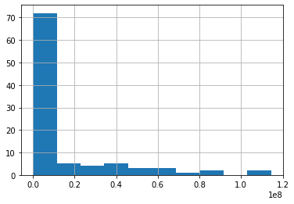
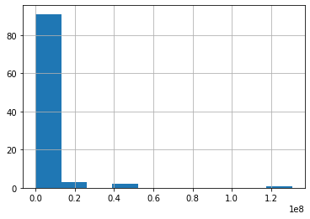
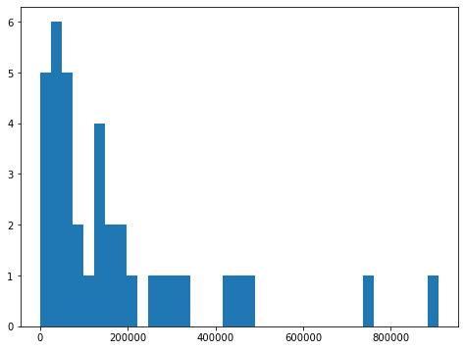
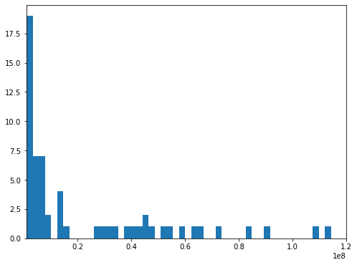
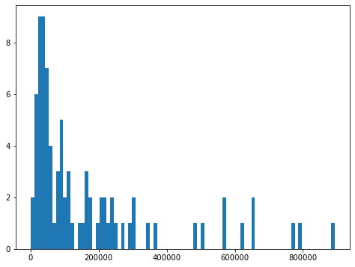
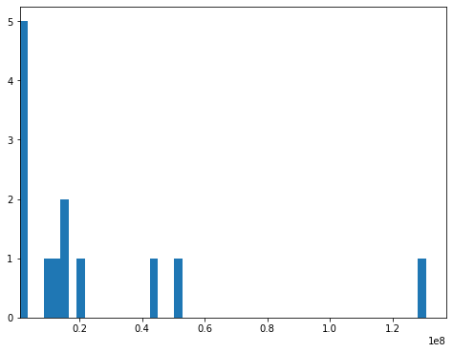
Distribution - Number of followers
97 Non-black Influencers/Users
97 Black Influencers/Users
37 users with < 1 million followers
60 users with ≥ 1 million followers
84 users with < 1 million followers
13 users with ≥ 1 million followers
range: 248 - 114,355,774 followers
range: 0 - 130,647,238 followers

Slide 48
Distribution - Number of followers
97 Black Influencers/Users
97 Non-black Influencers/Users
84 users with < 1 million followers
13 users with ≥ 1 million followers
37 users with < 1 million followers
60 users with ≥ 1 million followers
range: 0 - 130,647,238 followers
range: 248 - 114,355,774 followers

Slide 49
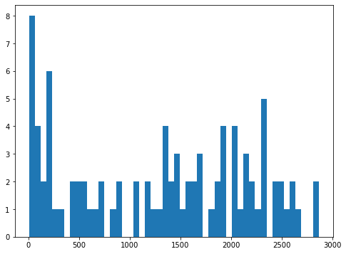
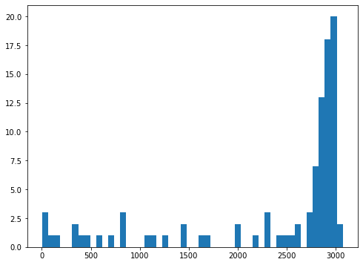
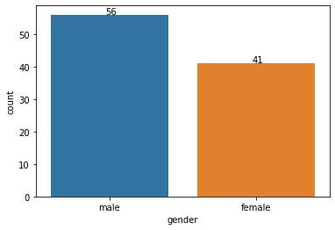
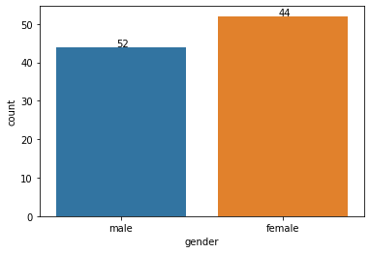
Distribution - Number of tweets
from Feb 1, 2020 to Oct 31, 2021
Non-black Influencers/Users
Black Influencers/Users
range: 9 - 2864 tweets
total: 117,907 tweets
range: 3 - 3070 tweets
total: 224,103 tweets
Gender Distribution
(m3inference)

Slide 50
Distribution - Number of tweets
from Feb 1, 2020 to Oct 31, 2021
Black Influencers/Users
Non-black Influencers/Users
range: 3 - 3070 tweets
total: 224,103 tweets
range: 9 - 2864 tweets
total: 117,907 tweets
Gender Distribution
(m3inference)

Slide 51
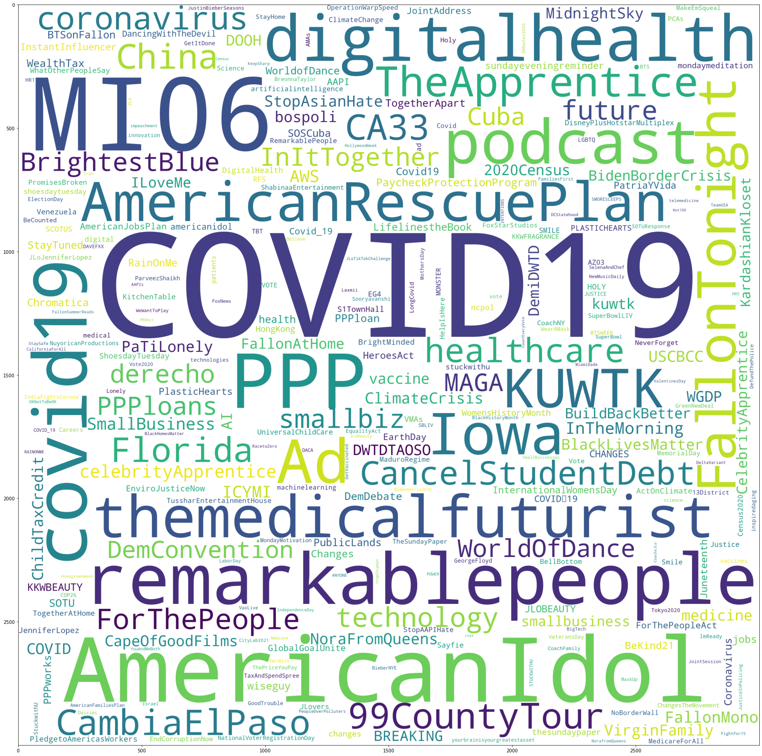
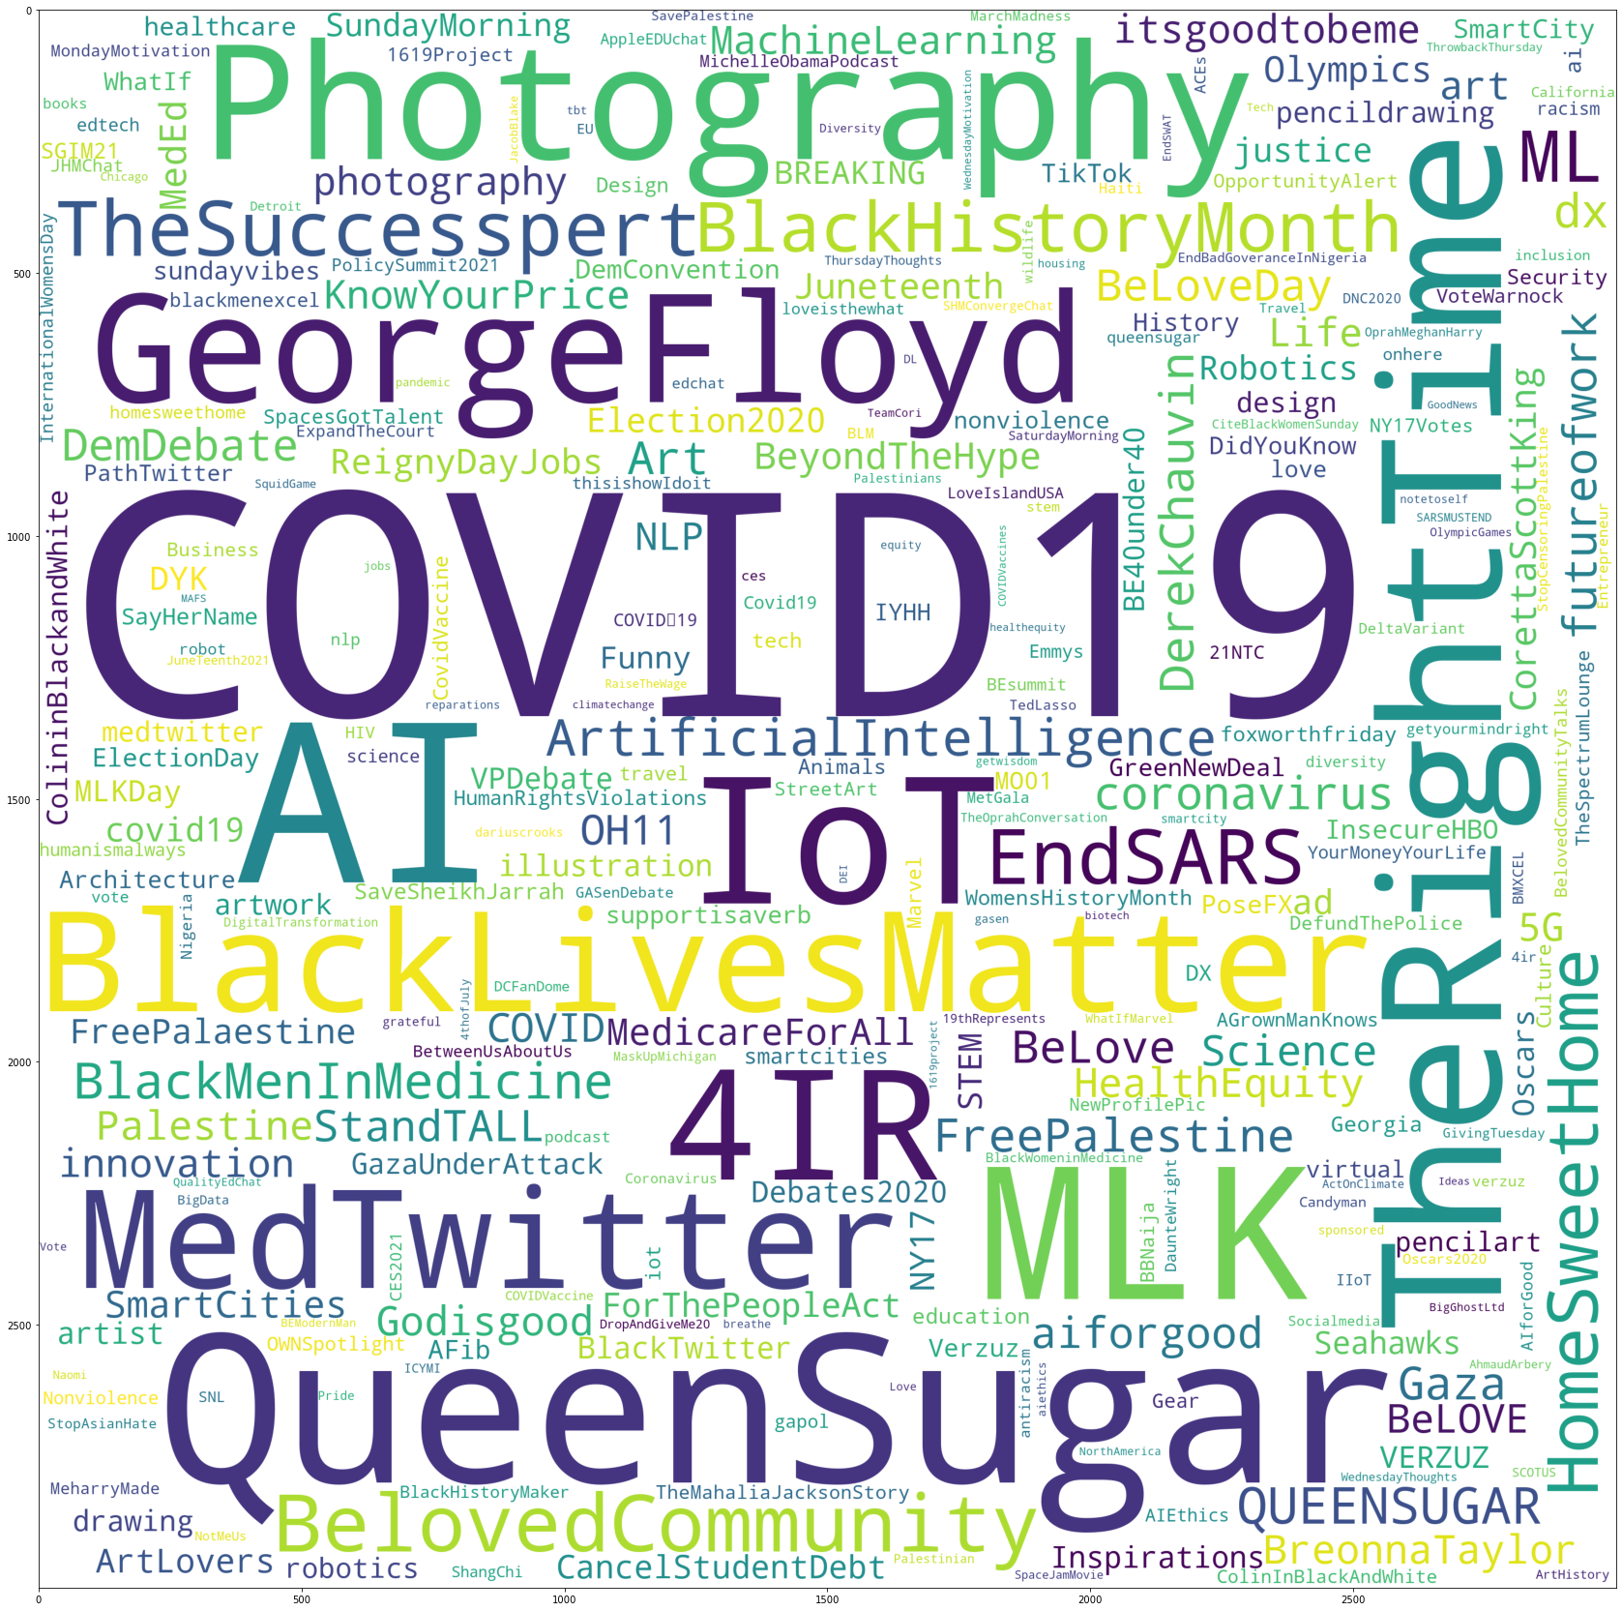
300 most common hashtags from 97 non-black influencers/users
300 most common hashtags from 97 black influencers/users

Slide 52
potentially black-related hashtags from 97 non-black influencers/users*
potentially black-related hashtags from 97 black influencers/users*
hashtag | count
BlackLivesMatter | 64
Juneteenth | 39
GeorgeFloyd | 22
BreonnaTaylor | 21
DefundThePolice | 19
BlackHistoryMonth | 17
BlackHomesMatter | 16
JusticeForGeorgeFloyd | 10
blacklivesmatter | 10
MLKDay | 8
BlackWomensEqualPayDay | 5
MLK | 4
breonnataylor | 3
BlackMaternalHealthWeek | 3
StrikeForBlackLives | 3
DerekChauvinTrial | 3
JusticeForBreonna | 3
TulsaRaceMassacre | 3
georgefloyd | 2
policebrutality | 2
BlackLivesMattter | 2
JusticeForBreonnaTaylor | 2
BlackWomensEqualPay | 2
BREONNATAYLOR | 2
NationalBlackVoterDay | 2
BirthdayForBreonna | 2
JusticeForGeorge | 2
hashtag | count
MLK | 324
GeorgeFloyd | 215
BlackLivesMatter | 211
TheSuccesspert | 190
BlackHistoryMonth | 159
BlackMenInMedicine | 149
DerekChauvin | 133
OH11 | 100
BreonnaTaylor | 94
CorettaScottKing | 68
Juneteenth | 65
BlackTwitter | 54
MLKDay | 53
BE40under40 | 51
MO01 | 43
SayHerName | 41
OWNSpotlight | 34
blackmenexcel | 34
VoteWarnock | 34
AGrownManKnows | 34
TheMahaliaJacksonStory | 33
1619Project | 33
TheSpectrumLounge | 33
DefundThePolice | 33
racism | 31
BlackHistoryMaker | 29
BelovedCommunityTalks | 29
MichelleObamaPodcast | 29
BetweenUsAboutUs | 28
MeharryMade | 28
DaunteWright | 27
BLM | 25
BMXCEL | 25
antiracism | 25
BlackWomeninMedicine | 22
JuneTeenth2021 | 21
CiteBlackWomenSunday | 20
AhmaudArbery | 19
JacobBlake | 18
breathe | 18
1619project | 17
HBCU | 16
WinWithBlackWomen | 16
BlackWhysMatter | 16
VoterSuppression | 16
ImplicitBias | 16
Nonviolence365 | 15
ElijahMcClain | 15
BlackGirlMagic | 15
CiteASista | 15
MLKonRacism | 15
blackwomanpower | 14
antiracism101 | 14
EndPoliceBrutality | 14
DerekChauvinTrial | 13
wearethepipeline | 13
TulsaRaceMassacre | 13
JusticeForGeorgeFloyd | 12
blackdoctorscovid19consortium | 2
Blackdoctorscovid19consortium | 2
*hashtags that have count > 1 are shown

Slide 53
potentially black-related keywords used by 97 black influencers in tweets
potentially black-related keywords used by 97 non-black influencers in tweets*
word_token | count
black | 11212
🏾 | 9118
🏿 | 2120
🏽 | 1756
niggas | 438
nigga | 438
black-owned | 135
anti-black | 95
blackness | 88
blacks | 70
anti-blackness | 40
non-black | 34
black-majority | 20
antiblack | 18
black-led | 17
nonblack | 8
majority-black | 7
blackstreamlive | 5
black-ish | 5
blackgirlnerds | 3
word_token | count
black | 1182
🏽 | 373
🏾 | 129
🏿 | 43
blacks | 13
black-owned | 12
blackface | 7
nonblack | 3
black-led | 2
anti-black | 2
anti-blackness | 2
antiblackness | 1
black-business | 1
majority-black | 1
*skin color icons might not be directly black-related since people of other ethnic groups use similar skin tones for their emoticons as well (e.g. people of South Asian, Middle Eastern, Hispanic, etc. ethnic groups)

Slide 54
word_token | count
health | 10
father | 9
mom | 9
account | 8
people | 8
senator | 7
american | 7
official | 7
husband | 7
director | 6
professor | 6
proud | 5
author | 5
public | 5
love | 5
analyst | 4
governor | 4
tweets | 4
views | 4
medical | 4
chief | 4
chair | 4
member | 4
wife | 4
advocate | 4
host | 4
book | 4
house | 3
grandfather | 3
md | 3
User Biographies
word_token | count
writer | 14
author | 9
former | 7
director | 7
founder | 7
podcast | 6
producer | 6
ig | 6
black | 6
prof | 5
senior | 5
editor | 5
actor | 5
contributor | 5
politics | 4
justice | 4
alum | 4
mom | 4
views | 4
la | 4
ceo | 4
host | 4
chair | 4
creator | 4
tweets | 4
co-founder | 4
health | 4
co-host | 4
advocate | 4
professor | 4
black-community related tokens & hashtags in biographies*
word_token | count
black | 6
#africology | 1
#wakandaforever | 1
#blackwomeninmedicine | 1
#blacklivesmatter | 1
african | 1
Top 30 most occurring tokens in biographies of 92* non-black influencers
(not including mentions)
* 5 of them do not have biography
Top 30 most occurring tokens in biographies of 93* black influencers
(not including mentions)
* 4 of them do not have biography
none found in the biographies of non-black influencers
*found in 11 unique users
black-community related mentions in biographies**
word_token | count
@blackgirlscode | 1
@blackgirlnerds | 1
@blackenterprise | 1
@blackreadingtoheal | 1
@blkmamasmatter | 1
**found in 5 unique users

Slide 55
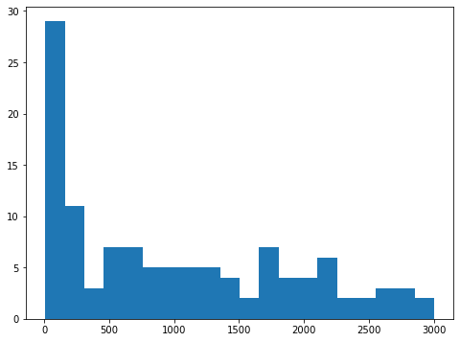
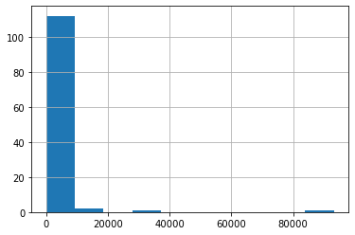
New Users
collected using sample query: "(#BlackMenInMedicine OR #blackwomanpower OR #BlackTwitter) (#Coronavirus OR #EndSARS)" - retrieved a sample of 1996 tweets with the hashtags that were tweeted by 116 new users
Number of Tweets
from Feb 1, 2020 to Oct 31, 2021
Number of Followers
range: 0 - 93,220 followers
range: 8 - 3002 tweets
total: 117,125 tweets
Note: tweet query string allows only up to 1,024 characters max
#BlackMenInMedicine, #blackwomanpower, #BlackTwitter were chosen because they were mainly used by black influencers as shown previously to get as many new users from the black community for this sample
Hashtags #Coronavirus, #ENDSARS were chosen randomly. Both of them were used heavily as shown in previous slides

Slide 56
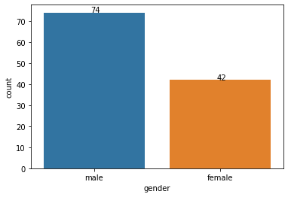
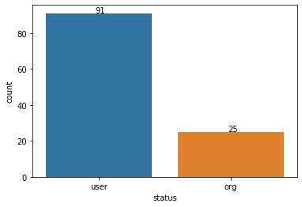
New Users (cont.)
Gender Distribution
(m3inference)
Organization Distribution
(m3inference)
will filter out those “users” that are considered organizations soon…

Slide 58
Project Direction
explore association between membership and hashtags (e.g. #BlackTwitterProject, #BlackMenInMedicine)
explore approaches to identify user’s membership (binary: black vs non-black)
biography/user description
most recent tweets
inference method (hashtags, linguistic pattern)

Slide 59
Black Twitter Project: current “pipeline”
completed
created pipeline
list of keywords & hashtags related to COVID & black community
created pipeline
extract new tweets
extract their users
completed
List of 100 influencers’ twitter handles
extracted 224,103 tweets, hashtags, biography, etc.
keywords & hashtags
feature construction:
# black-related hashtags and keywords for each user found in the past 50 (or more) tweets and biography
classifying users between black and non-black based on # black-related hashtags & keywords found in the past 50 tweets and biography
for comparison: build a list of 100 non-black influencers
completed
created pipeline

Slide 60
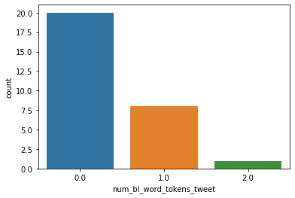
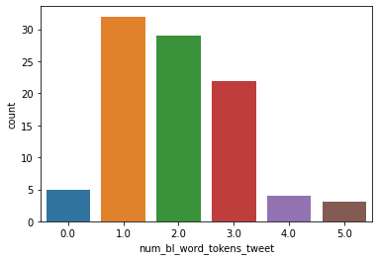
number of black-related keywords found in the most recent 100 tweets from each user
30 influencers not from the Black community*
97 influencers from the Black community
*list out common keywords non-black influencers used in their tweets if they used

Slide 61
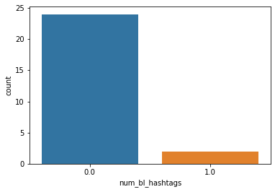
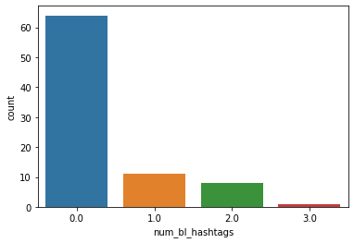
number of black-related hashtags found in the most recent 100 tweets from each user
30 influencers not from the Black community
97 influencers from the Black community
*list out common keywords non-black influencers used in their tweets if they used

Slide 62
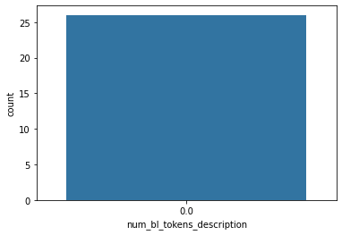
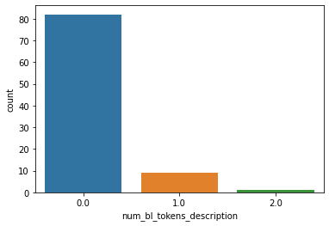
number of black-related keywords & hashtags found in the user description/biography
30 influencers not from the Black community
97 influencers from the Black community
separately analyze the user biographies the same way as tweets (keywords, maybe hashtags) - separate list of black-related keywords

